Slide 1
Problem Statement
Running GenAI on Intel AI Laptops and Simple LLM Inference on CPU and fine-tuning of LLM Models using Intel® OpenVINO™

Slide 2
Unique Idea Brief (Solution)
Utilizing the TinyLlama model for running LLM inference on Intel AI laptops using OpenVINO for efficient model execution. This approach leverages the capabilities of OpenVINO to optimize model performance on Intel hardware, ensuring that the inference process is both fast and resource-efficient.

Slide 3
Features Offered
Efficient LLM Inference on CPU
Using Open VINO to optimize LLM inference on Intel CPUs.
Model Fine-Tuning
Fine-tuning LLM models to create custom applications like chatbots.
Context Management
Managing context tokens to handle large sequences efficiently.
Additional Features
Support for dynamic axes in the model to handle varying input sizes.
Integration with popular NLP libraries like Hugging Face.

Slide 4
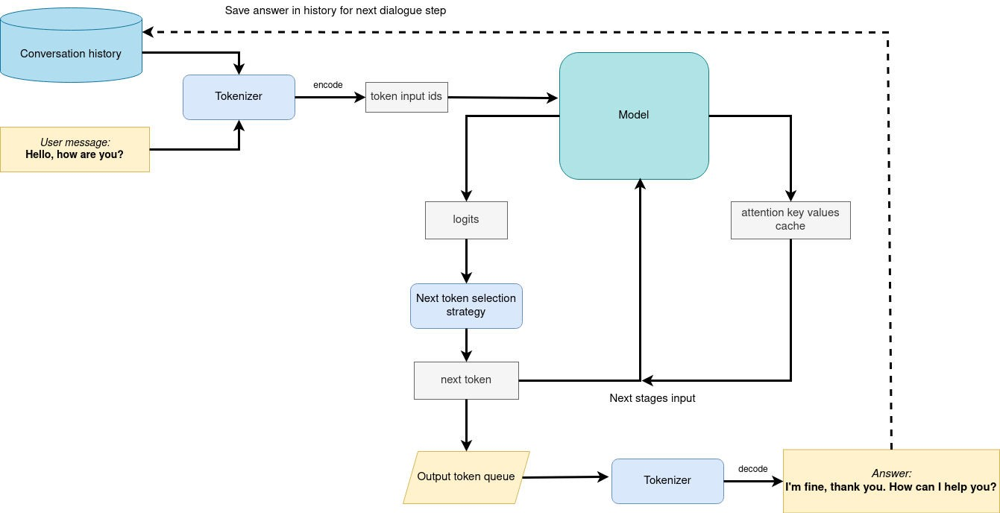
Process Flow

Slide 5
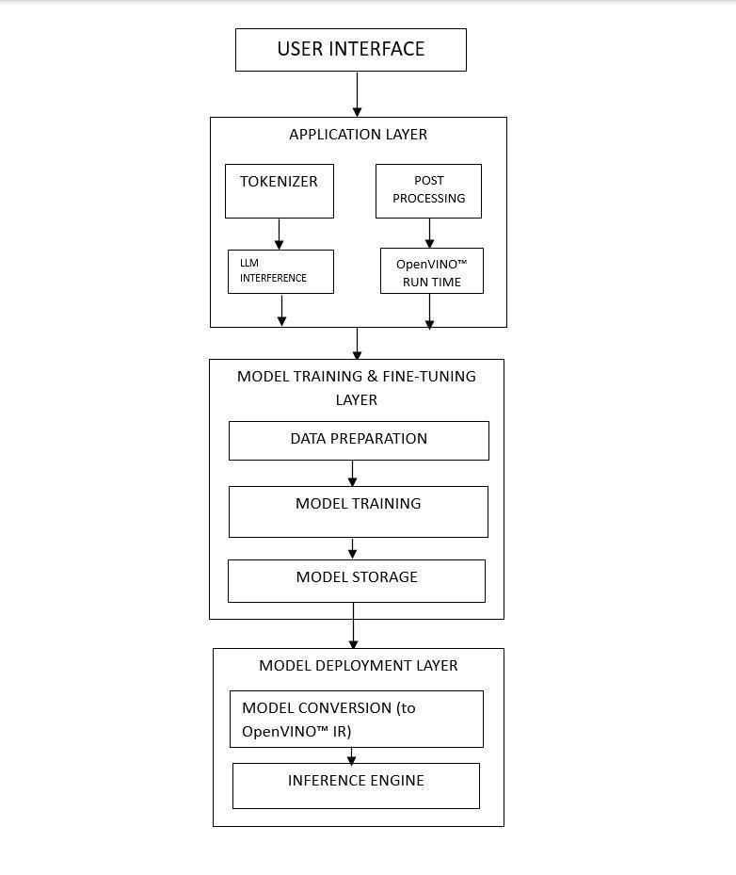
Architecture Diagram

Slide 6
Technologies Used
Python:
For scripting and running the processes.
Hugging Face Transformers:
For tokenization and model handling.
PyTorch:
For exporting the model to ONNX format.
Intel® OpenVINO™ Toolkit :
For converting and compiling the model for efficient inference.
ONNX:
As an intermediate format for model conversion.

Slide 7
Team Members and Contribution
Optimization using OpenVino, Model Training and Basic LLM Model:
Chandrasekhar C A, Jobin Tom and Muhammed Adil.
Testing and UI creation:
Aaron James Koshy and Kevin Thomas.
Documentation :
Kevin Thomas and Aaron James Koshy.

Slide 8
Conclusion
Summary:
This project demonstrates the efficient use of Intel AI tools for running LLM inference and fine-tuning on CPUs.
Future Work:
Explore further optimizations and support for additional models.
Final Thoughts:
Leveraging Intel OpenVINO for AI applications can significantly enhance performance and efficiency.

